Slide 1
RET Project: Air Quality Monitoring
Near a Major Roadway
Dean Stocker
University of Cincinnati Blue Ash College
Physics
Marie Pollitt
Felicity-Franklin Middle School
8th Grade Science
The RET program is funded by
the National Science Foundation,
Grant ID# EEC-1710826
Notes:
Next week: include more constraints such as rain, Grad students conduct their own research, July 4,
Talk about upcoming instrument and difference in pressure from am to pm

Slide 2
Acknowledgements
Project Faculty Mentors | Dr. Sivaraman Balachandran Dr. Mingming Lu
Graduate Research Assistant | Ms. Madhumitaa Roy
Field Research Team | Mr. Dexter Adams Mr. Yajna Jathan Mr. Deshui Xu
RET Project Director & PI | Dr. Anant R. Kukreti
Resource & Grant Coordinators | Ms. Debbie Liberi Ms. Kristin Barnes
RET Engineering Resource Teacher | Ms. Pam Truesdell

Slide 3
Table of Contents
Abstract
Introduction
Background Literature Review
Goals and Objectives
Research Training Received
Research Tasks
Timeline
Unit Topics, Essential Questions, Challenges
Progress Made

Slide 4
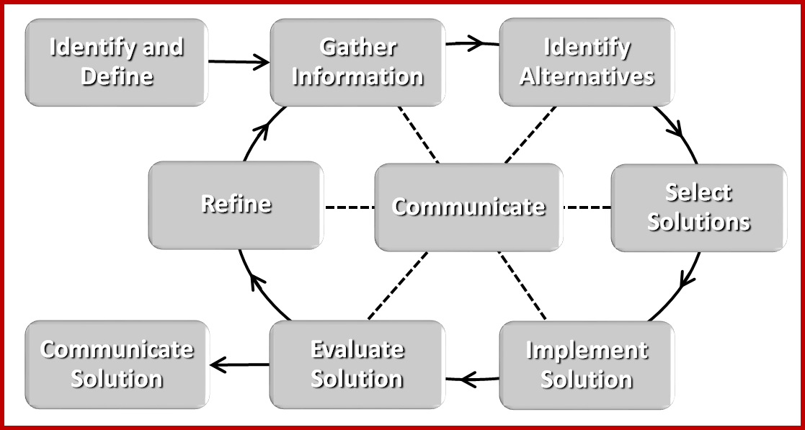
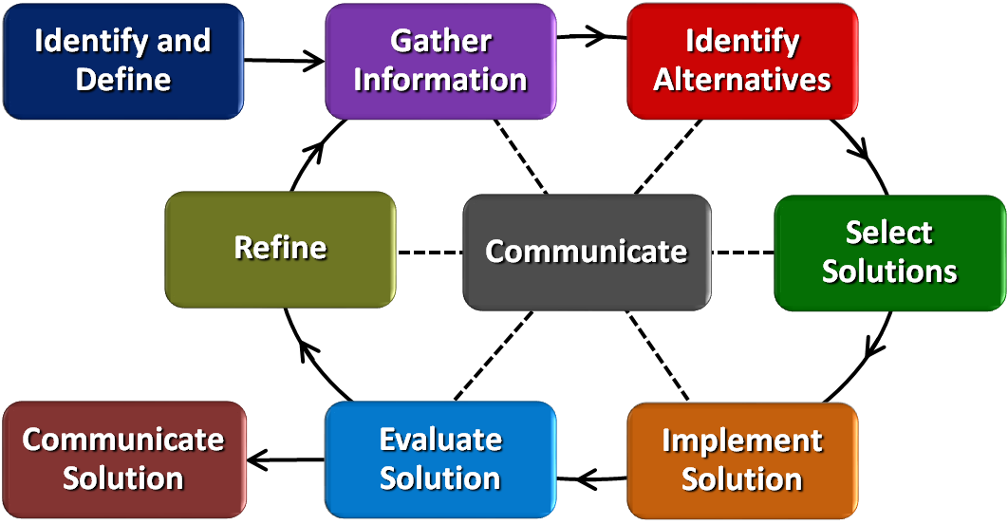
Table of Contents = EDP

Slide 5
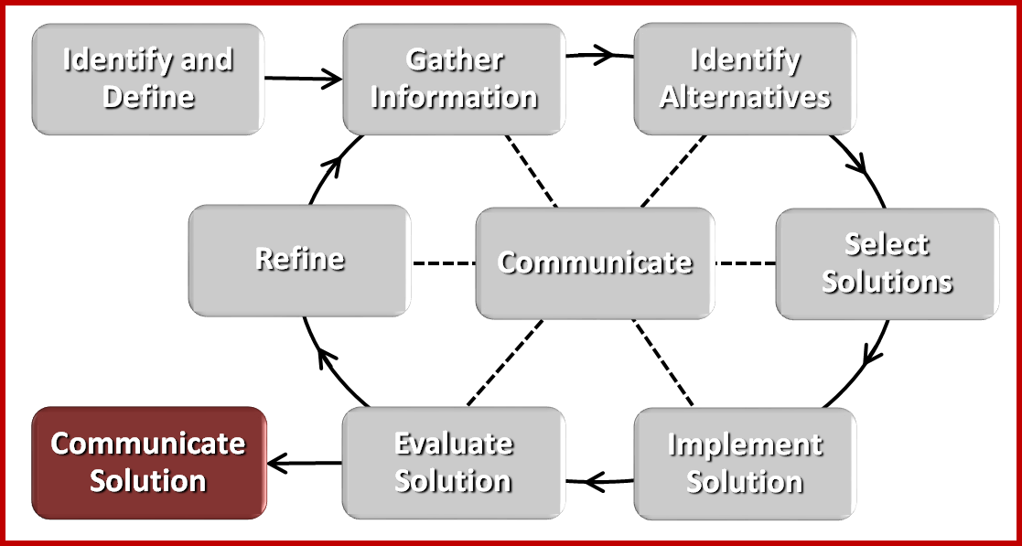
Abstract
Problem
Significant correlation between human health and both black carbon (BC) and particulate matter (PM_{2.5})
Project Objectives
Collect and analyze BC and PM_{2.5} in Camp Washington
Results
Considerable spatial variation
Higher concentrations in the morning
BC is higher in the southern part of Camp Washington

Slide 6
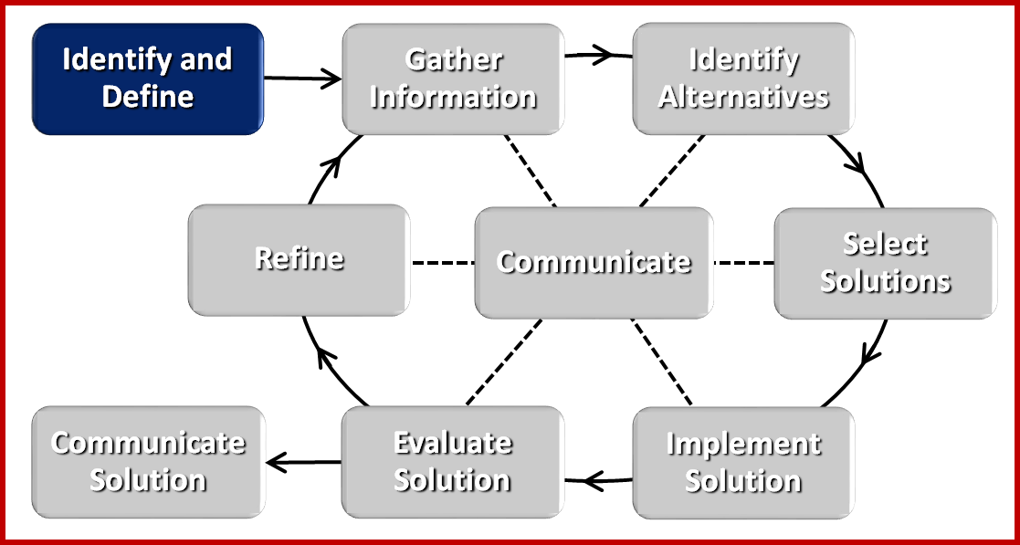
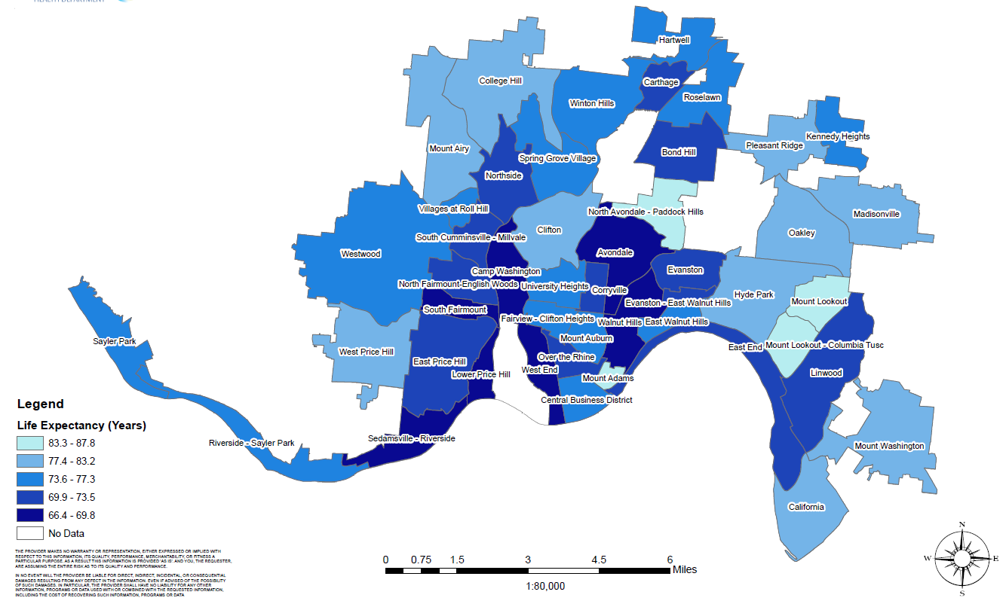
Introduction: The Problem
Notes:
BC is produced both naturally and by human activities as a result of the incomplete combustion of fossil fuels, biofuels, and biomass. Primary sources include emissions from diesel engines, cook stoves, wood burning and forest fires. (https://www.c2es.org/site/assets/uploads/2010/04/what-is-black-carbon.pdf)
PM2.5 refers to atmospheric particulate matter (PM) that have a diameter of less than 2.5 micrometers, which is about 3% the diameter of a human hair. (https://blissair.com/what-is-pm-2-5.htm)

Slide 7
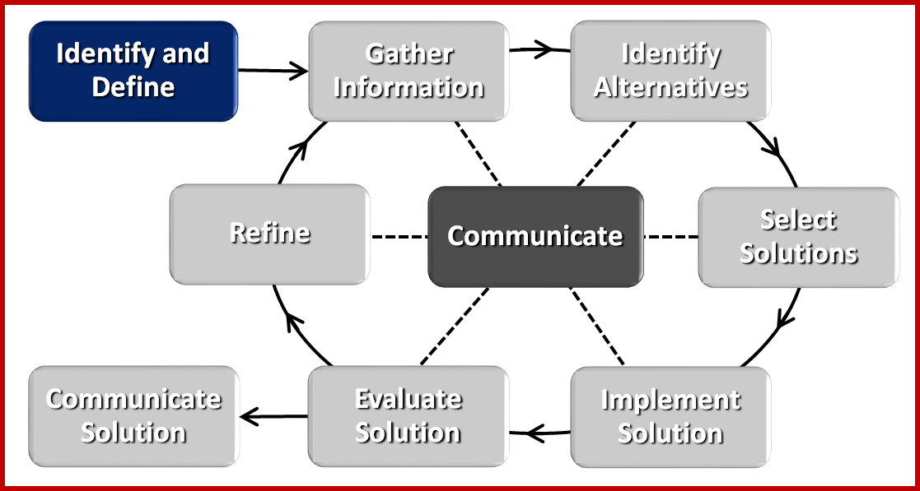
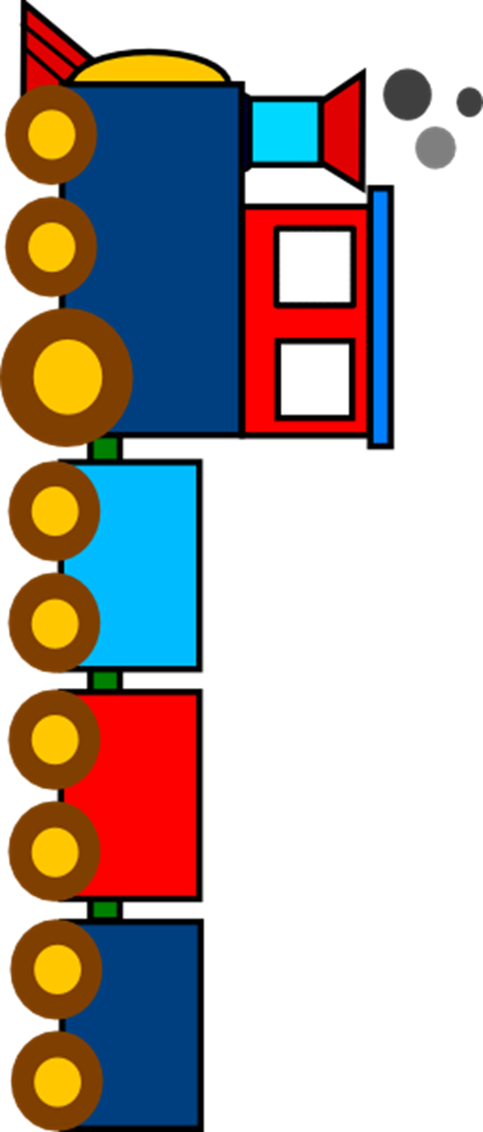
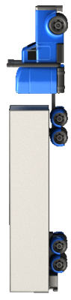
Introduction: Essential Question
How does
air pollution generated on
I-75 and in
the railyard
affect
life expectancy
in Camp Washington?
Notes:
BC is produced both naturally and by human activities as a result of the incomplete combustion of fossil fuels, biofuels, and biomass. Primary sources include emissions from diesel engines, cook stoves, wood burning and forest fires. (https://www.c2es.org/site/assets/uploads/2010/04/what-is-black-carbon.pdf)
PM2.5 refers to atmospheric particulate matter (PM) that have a diameter of less than 2.5 micrometers, which is about 3% the diameter of a human hair. (https://blissair.com/what-is-pm-2-5.htm)

Slide 8
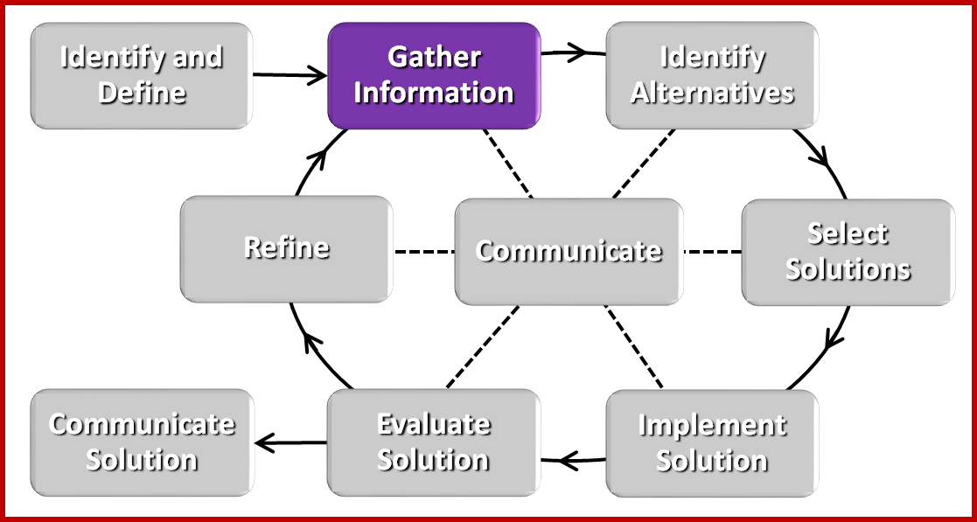
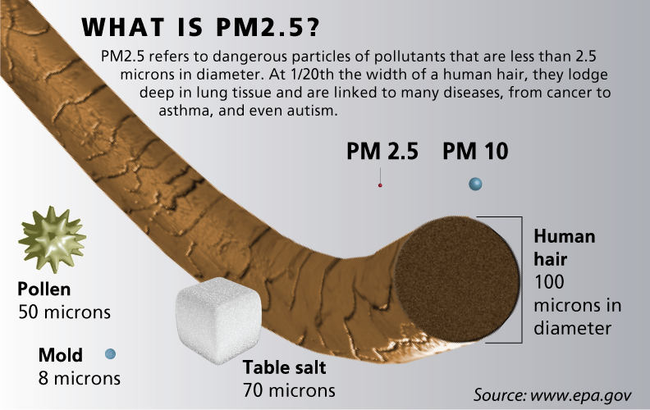
Background
Notes:
PM 2.5 is particles smaller than 2.5 microns (3% of the width of a human hair)

Slide 9
Background
What is black carbon?
Notes:
PM 2.5 is particles smaller than 2.5 microns (3% of the width of a human hair)

Slide 10
Background Literature Review
Component of Pollution | Reduction | Increase in Life Expectancy
PM_{2.5} | 1 μg/m³ | 21 days
Elemental (Black) Carbon | 0.55 μg/m³ 0.70 μg/m³ 0.41 μg/m³ | 3.6 months 3.1 months 4.5 months
Janssen, N. A., Hoek, G., Simic-Lawson, M., Fischer, P., van Bree, Ll, et al. (2011). “Black carbon as an additional indicator of adverse health effects of airborne particles compared with PM10 and PM2.5”. Environmental Health Perspectives, 119(12), 1691-1699.
Notes:
PM 2.5 is particles smaller than 2.5 microns (3% of the width of a human hair)

Slide 11
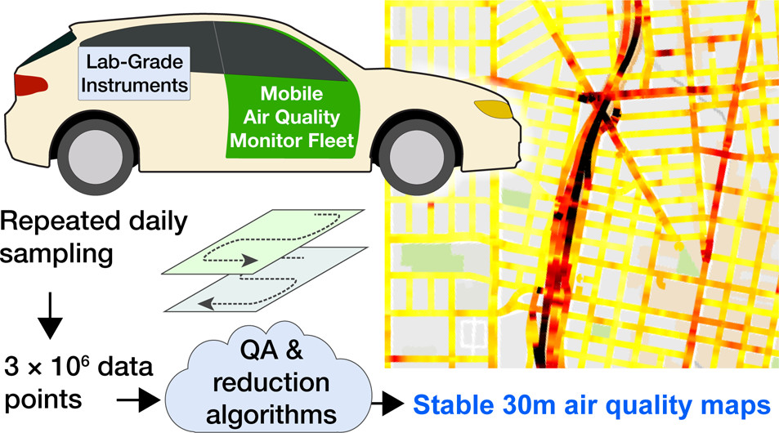
Background Literature Review
Apte, J. S., Messier, K. P., Gani, S., Brauer, M., Kirchstetter, T. W., Lunden, M. M., et al. (2017). "High-Resolution Air Pollution Mapping with Google Street View Cars: Exploiting Big Data". Environmental Science & Technology, 51, 6999-7008.
Notes:
30 km^2 area, took data daily (6-8 hrs/day) for a year.

Slide 12
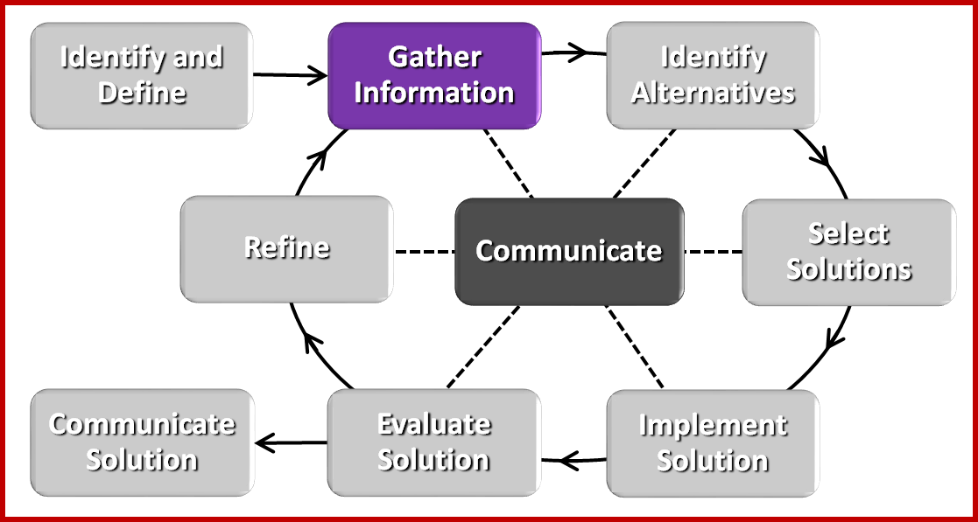
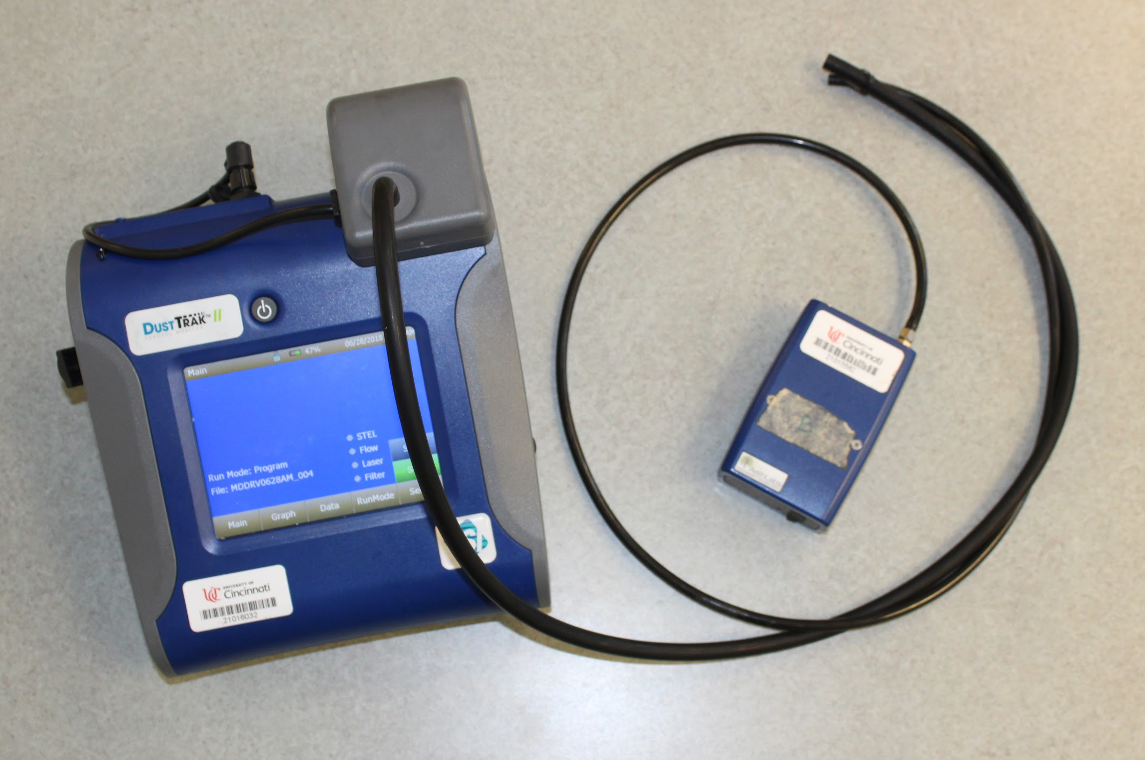
Research Training Received
DustTrak ™ II
Measures PM_{2.5}
MicroAeth® AE51
Measures BC
Analysis: MatLab, AETH Lab, Google Maps
Notes:
Instruments have fans that pull air in through the tubes. Have the actual instruments available for people to see. Note that only two of each are available to us.

Slide 13
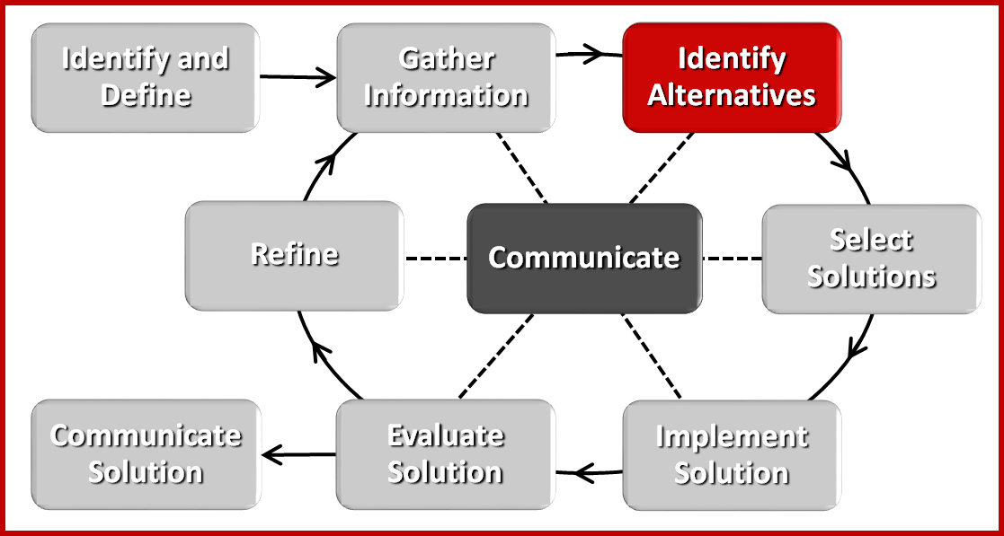
Research Task: Finding an Approach
Can we get into the railyard?
?
?
?
Commercial areas?
?
?
?
Residential areas?

Slide 14
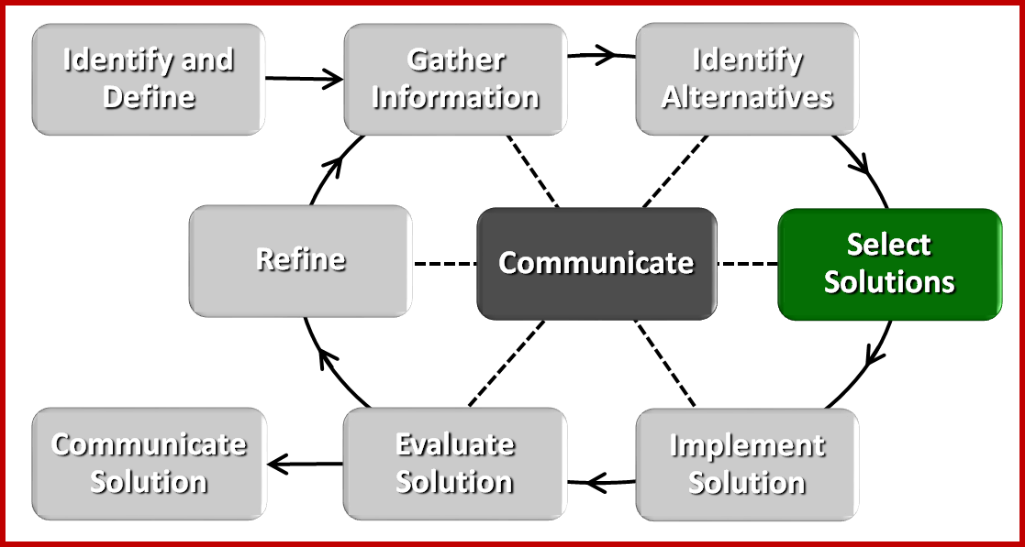
Research Task: Finding an Approach
Driving loop
7 - 8:30 AM
and
4 - 5:30 PM
EPA monitoring station
Construction site
Mixed residential and commercial
Driving loop gives simultaneous
data on I-75 and
in the community
Does not capture residential area
I-75
Commercial, near railyard

Slide 15
Research Task: Finding an Approach
Driving loop
7:00 - 8:30 AM
and
4:00 - 5:30 PM
Community swimming pool
Walking loop
7:00 - 8:30 AM
and
4:00 - 5:30 PM
Driving loop gives simultaneous
data on I-75 & in the community.
Walking loop covers residential, commercial, & mixed areas.
Notes:
Introduce the idea that 60 second data won’t work for our driving loop. Mention the map is zoomed in from the previous map to show the neighborhood north and south of Hopple Street.

Slide 16
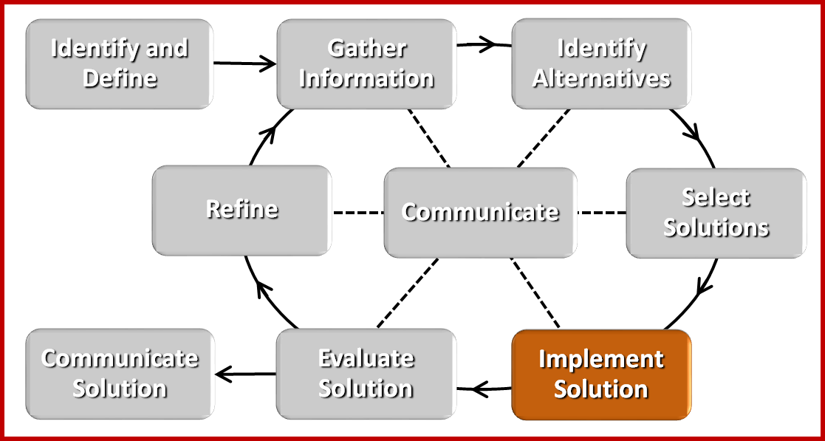
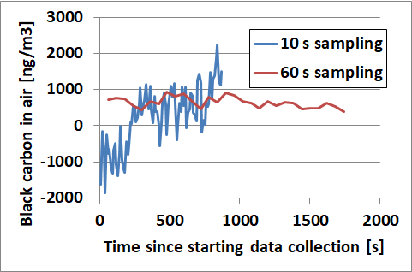
Collecting Data
To get usable highway measurements in a car, we need a faster data rate than is normally used…
...but that means less reliable data at each point.

Slide 17
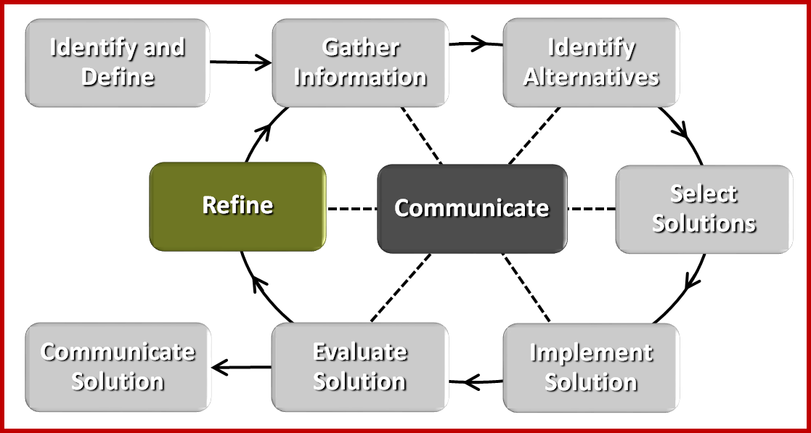
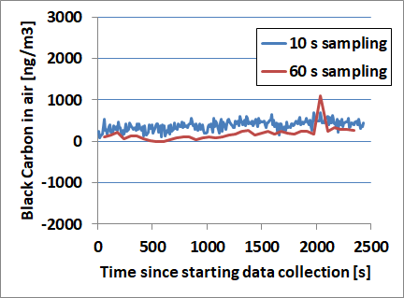
Collecting Data
The BC sensor is sensitive to vibration, so we padded it.
Scary data, sitting on a table
outside with no padding.
Good data, sitting in a
running car with padding.

Slide 18
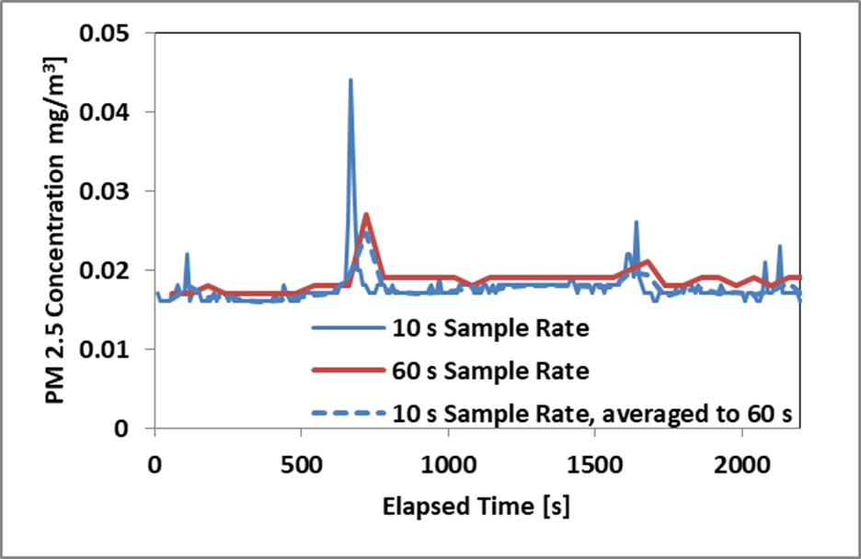
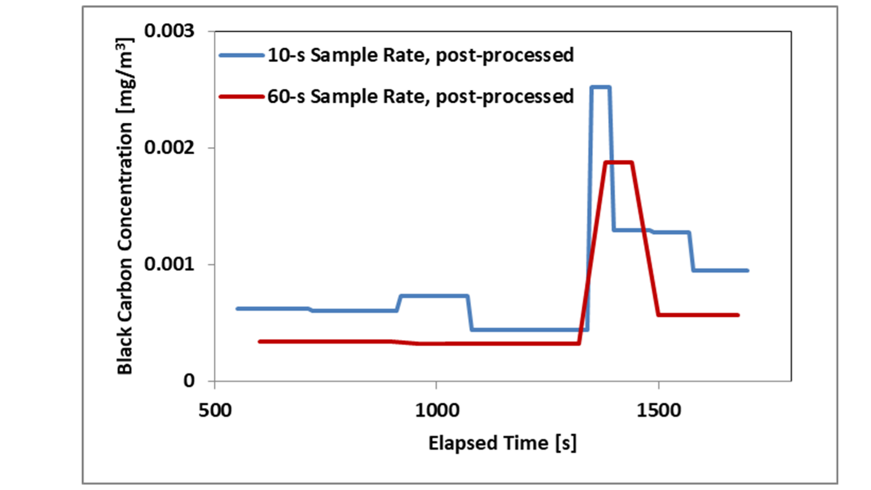
Collecting Data
Colocation Between Sets of Instruments While Sitting
6% difference
between PM_{2.5} detectors
50% difference
between black carbon detectors

Slide 19
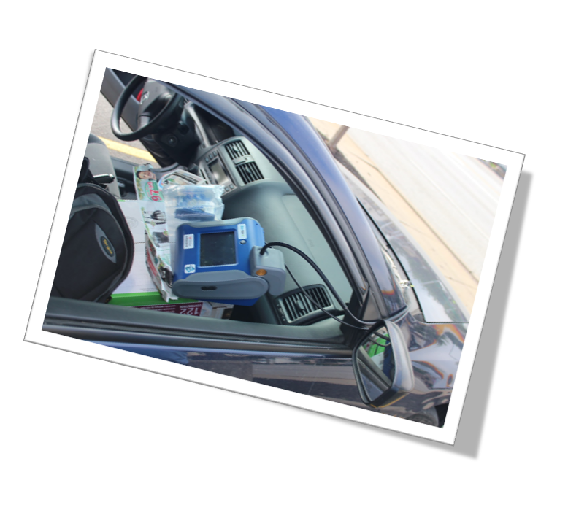
Collecting and Analyzing Data

Slide 20
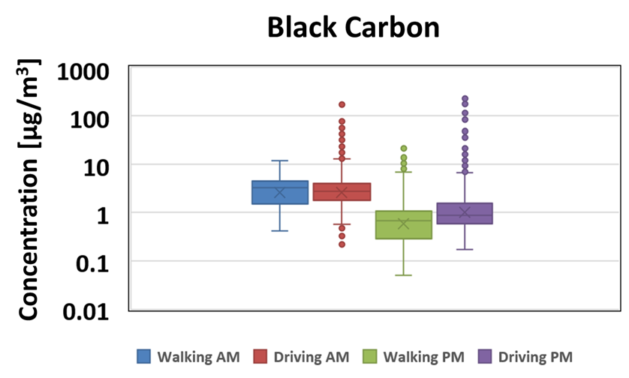
Results
Different
Same
Same
Different
Notes:
Map map behind roads
Add bar graphs that include standard deviation for PM2.5 for walking (am,pm) and driving (am,pm)

Slide 21
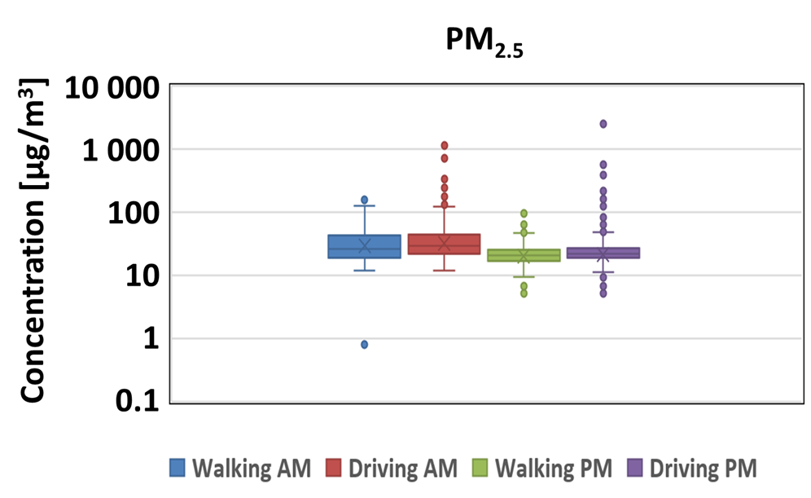
Results
Different
Same
Same
Different
Notes:
Map map behind roads
Add bar graphs that include standard deviation for PM2.5 for walking (am,pm) and driving (am,pm)

Slide 22
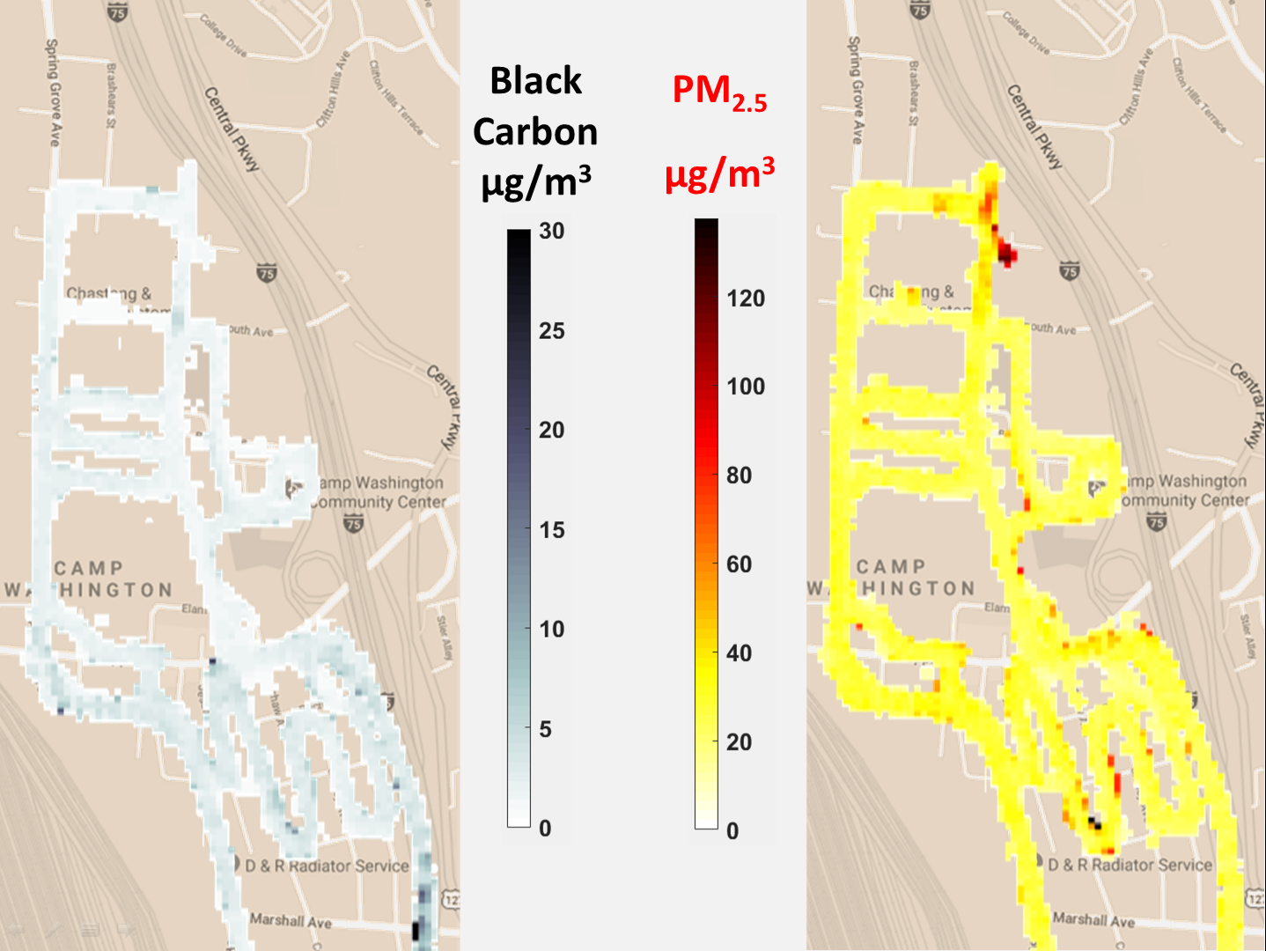
Results
Construction Site
Notes:
Map map behind roads
Add bar graphs that include standard deviation for PM2.5 for walking (am,pm) and driving (am,pm)

Slide 23
Results
Considerable spatial variation in BC and PM_{2.5} concentrations
Concentrations higher in mornings than in afternoons
“Mixing layer” is smaller in the morning
BC is higher in the southern part of Camp Washington.
More industrial pollution?
Wider railyard?
Less distance between railyard and interstate?

Slide 24
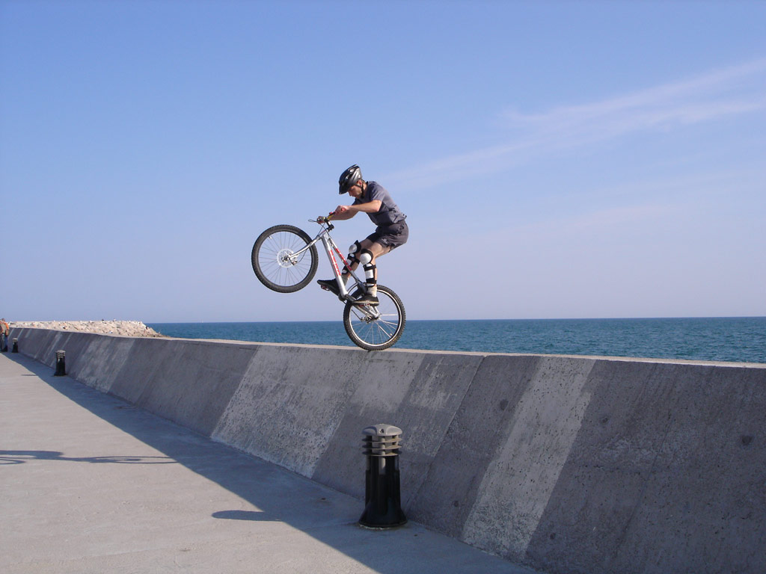
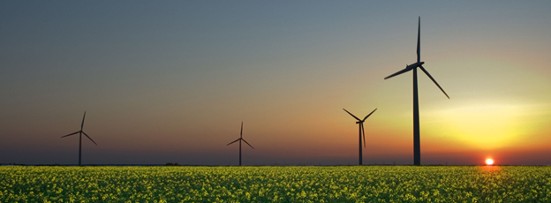
Dean’s Unit: Physics is Everywhere
Essential Question: How is physics relevant to our lives?
Challenge: Find a way to clearly demonstrate how physical concepts are related to something you care about in your life.
(Public domain)
(credit: Toudilo, Wikimedia Commons)
(credit: Jürgen from Sandesneben, Germany, Wikimedia Commons)

Slide 25
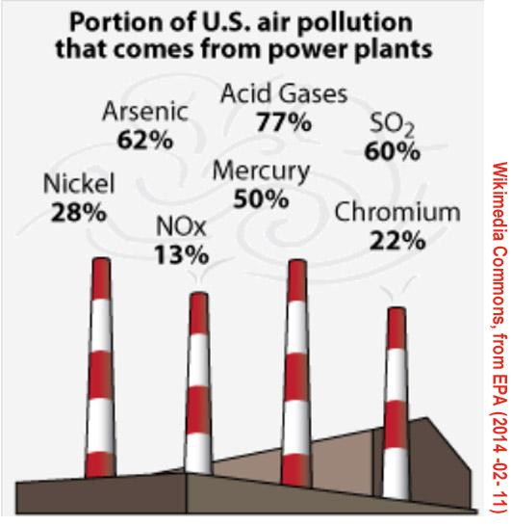
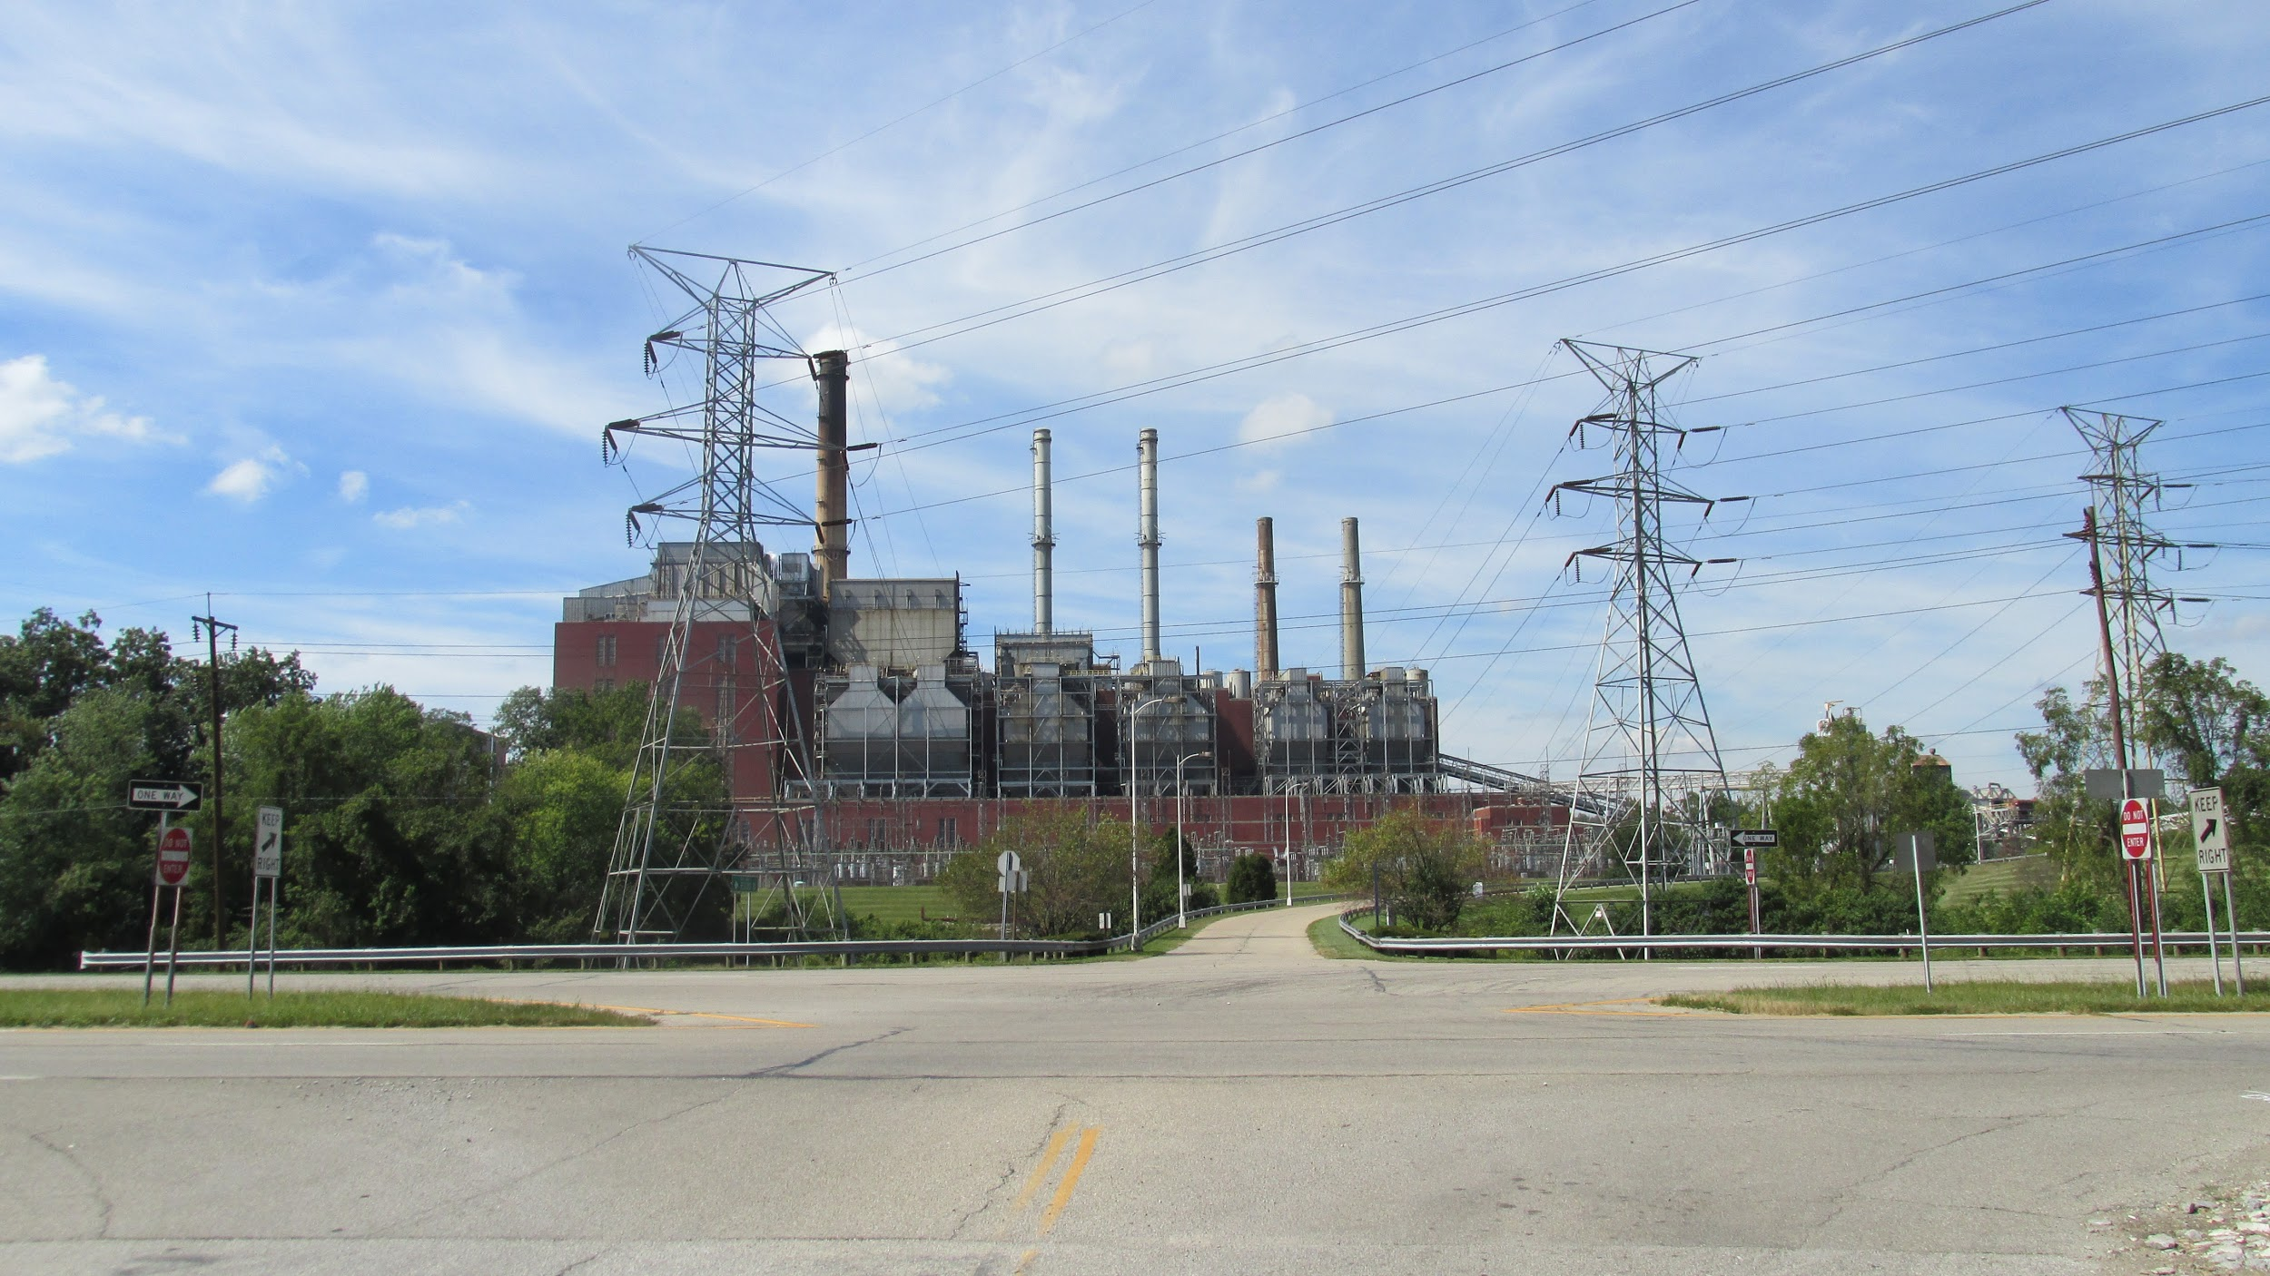
Marie’s Unit: Environmental Remediation
Essential Question: How can we safely clean up pollutants at a power plant?
Challenge: Students will design a plan to safely clean up the ash ponds at Beckjord.
By Aesopposea from Wikimedia Commons

